Slide 1
Firefox 4
The New Awesome of the Open Web

Slide 2
Firefox 4
Fast, Powerful, & Empowering
Notes:
Fast: making Firefox super-duper fast
Powerful: enabling new open, standard Web technologies (HTML5 and beyond!),
Empowering: putting users in full control of their browser, data, and Web experience.
http://blog.mozilla.com/blog/2010/05/10/firefox-4-vision-fast-powerful-and-empowering/

Slide 3
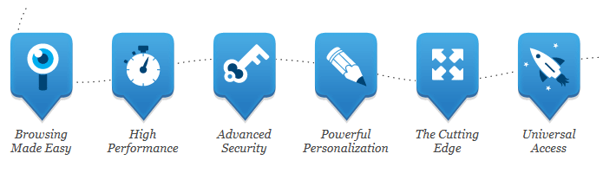
New Firefox Features
Bringing together all kinds of awesomeness to make browsing better for you

Slide 4

Browsing Made easy
The Awesome Bar, Better Tabs & More

Slide 5
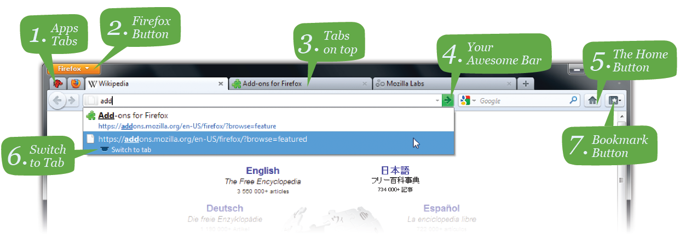
New Interface

Slide 6

Awesome Bar
Find the sites you love in seconds
Autocomplete from history, bookmarks & tabs
The Awesome Bar learns as you use it
Notes:
How Awesome is the Awesome Bar? As awesome as a wizard riding a squid with a monkey apprentice, fighting robot sharks IN SPACE

Slide 7

Stay In Sync
Sync between your desktop and mobile
Access your history, passwords & bookmarks on all your devices
Notes:
Sync seamlessly connects your desktop and mobile Firefoxes, so you can access your browsing history, passwords, bookmarks and even open tabs no matter which device you use. Access years of desktop browsing the first day you fire up your mobile, and use saved passwords from your desktop to fill out forms on your phone.
Now you can surf the Web on your desktop, get up in the middle of browsing and have your open tabs ready and waiting on your mobile, just as you left them. Your browsing will never be the same! Learn more about Sync or get Firefox on your phone.

Slide 8
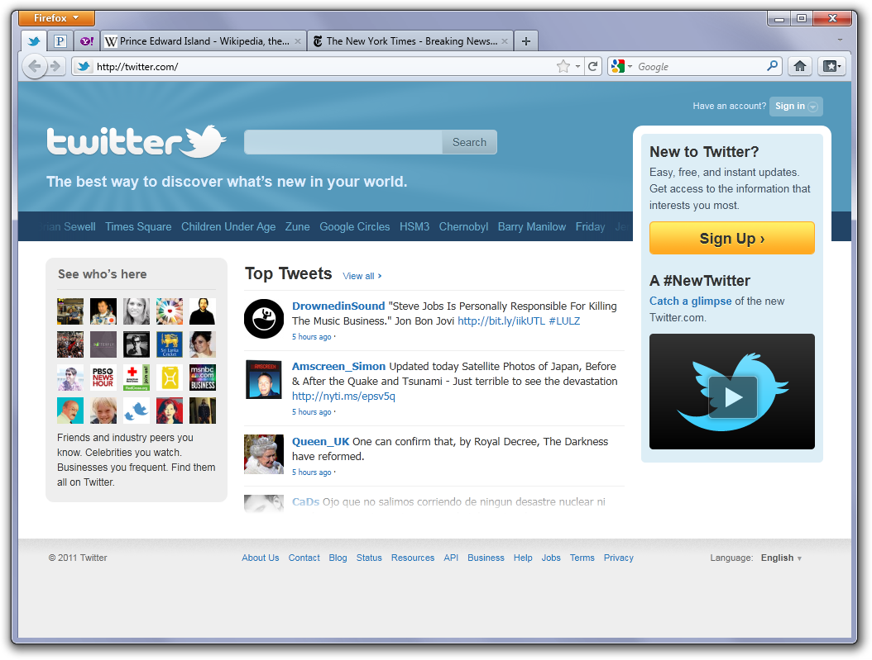
AppTab

Slide 9
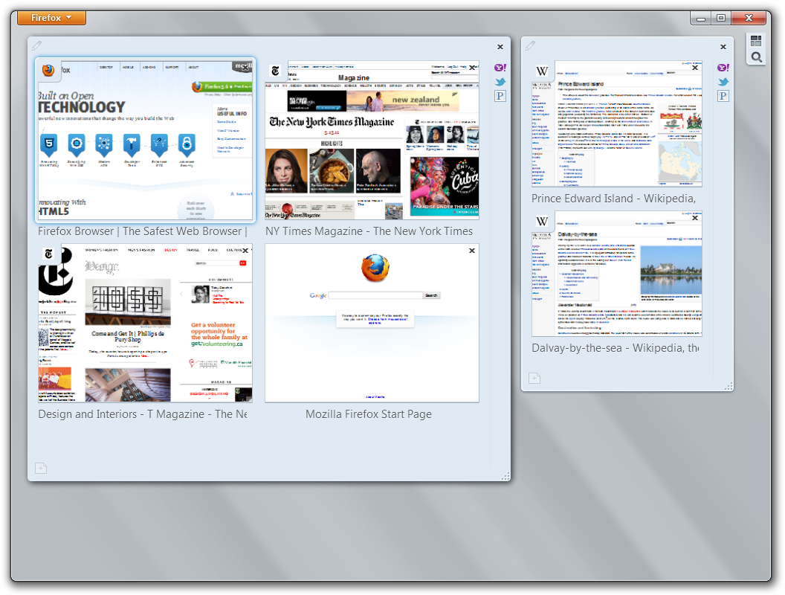
Panorama

Slide 10

High Performance
Super Speed, Crash Protection & More

Slide 11

Fastest Firefox Evar
View Web pages way faster, using less of your computer’s memory.
6 times faster
Improved start-up & page load times
http://www.flickr.com/photos/lensdude/4891914929/
Notes:
Super Speed
With faster start-up times, rapid graphics rendering and improved page load speed, the latest version of Firefox is full of major performance improvements you’ll notice instantly. From integrating Compartments and more efficiently managing JavaScript objects to supporting ECMAScript5 and improvements to the JägerMonkey JavaScript engine, we’ve been working hard to make this the most powerful Firefox ever.
Real World Performance
Having a super-fast JavaScript engine is definitely important, but since those changes are often measured in milliseconds, sometimes what matters even more is the way the browser feels when you’re actually using it. That’s why we’re constantly optimizing Firefox to be great for the way you use the Web — things like making new tabs open up more quickly, or having the Awesome Bar provide results even faster. In the end, it’s about getting you where you need to go as quickly and easily as possible.

Slide 12
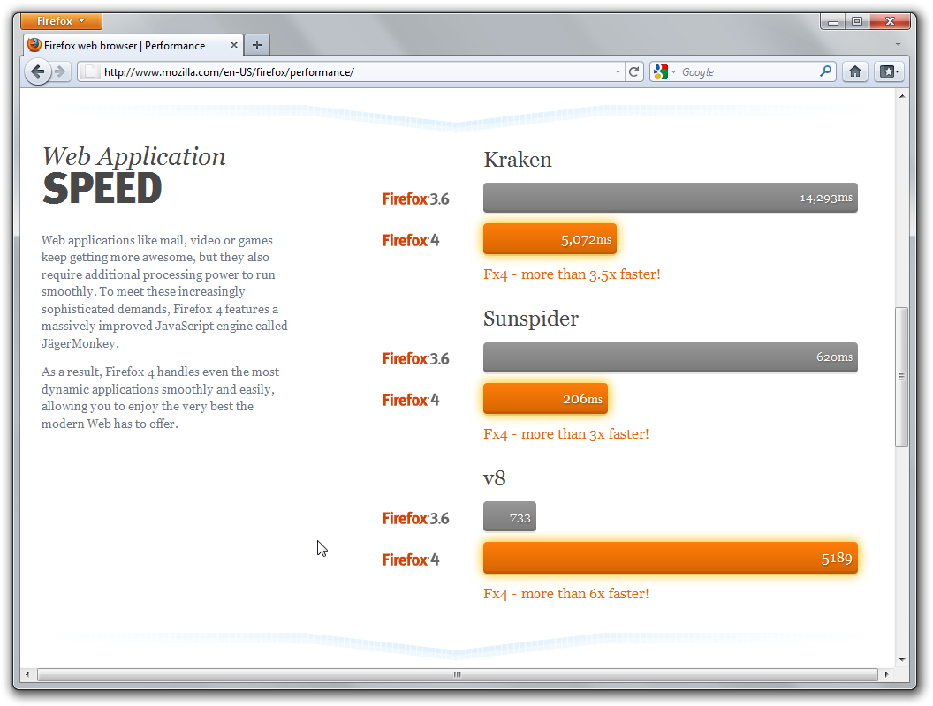
Fastest Firefox Evar

Slide 13

Crash Protection
Recover from a crash of Adobe Flash, Apple QuickTime or Microsoft Silverlight.
Simply reload the page to restart the plugin and try again
http://www.flickr.com/photos/cannibal_stew/4471818425/
Notes:
Firefox provides uninterrupted browsing when there is a crash in the plugins for Adobe Flash, Apple QuickTime or Microsoft Silverlight.
If one of these commonly-used plugins crashes or freezes, it won't affect the rest of the browser. You can simply reload the page to restart the plugin and try again

Slide 14

Hardware Acceleration
Super-fast graphics
WebGL bring 3D to Firefox
http://www.flickr.com/photos/joes-place/4941060146
Notes:
Super-fast graphics acceleration of video & Web content with a new graphics system that uses Direct 2D & 3D on Windows
WebGL brings 3D graphics to Firefox, opening the door to vivid games and new kinds of visualizations and experiences

Slide 15

Advanced Security
Do Not Track, Anti-Malware & More

Slide 16


Slide 17

Do Not Track
Opt out of behavioral tracking
Keep your browsing habits private
http://www.flickr.com/photos/volk/3404715209
Notes:
Many sites track your online behavior and sell that data to advertisers. If that makes you uncomfortable, Firefox lets you tell sites you want to opt out of behavioral tracking and keep your browsing habits private.

Slide 18

Private Browsing
Slip in and out of private browsing mode quickly to protect your browsing
Forget This Site
Clear Recent History
http://www.flickr.com/photos/splorp/148963020
Notes:
Slip in and out of private browsing mode quickly to protect your browsing
Forget This Site: Having second thoughts about having visited a certain site? Remove every trace of ever having been there!
Clear Recent History
Clear all your private data or just your activity over the past few hours with a few quick clicks. You have full control over what to delete, and then your info is gone for good—on your own computer or the one at your local library. It’s that easy.

Slide 19
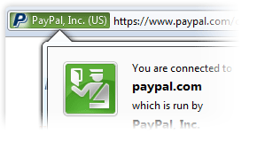
Instant Website ID
Instant identity overview.
Dig Deeper: How many times have you visited? Are your passwords saved?
Check up on suspicious sites & avoid Web forgeries
Notes:
Instant Web Site ID
Want to be extra sure about a site’s legitimacy before you make a purchase? Click on its favicon for an instant identity overview. Another click digs deeper: how many times have you visited? Are your passwords saved? Check up on suspicious sites, avoid Web forgeries and make sure a site is what it claims to be.

Slide 20

Security Baked-In
Anti-Virus Integration
Anti-Phishing detection
Better Cross-Site Scripting Protection
Secure Auto-Updates
Detect old plug-ins
http://www.flickr.com/photos/10404945@N05/1953114740/
Notes:
Security
Content Security Policy
The Content Security Policy in Firefox is designed to shut down cross-site scripting attacks by providing a mechanism for sites to explicitly tell the browser which content is legitimate. The browser can then disregard any content that has not been blessed by the site, keeping you protected in the process.
Customized Security Settings
Control the level of scrutiny you’d like Firefox to give a site. You can even enter exceptions—sites that don’t need the third degree. Customize settings for passwords, cookies, loading images, and installing add-ons for a fully empowered Web experience.
Parental Controls
Enforce parental control settings you’ve entered on Windows 7 to stop unwanted downloads and more.
Secure Updates
Firefox looks for a secure connection before installing or updating add-ons, third-party software, and Personas.
Anti-Virus Integration
Firefox integrates elegantly with your Windows anti-virus software. When you download a file, your computer’s anti-virus program automatically checks it to protect you against viruses and other malware, which could otherwise attack your computer.
Anti-Phishing
Shop and do business safely on the Internet. Firefox gets a fresh update of forgery sites a whopping 48 times a day, so if you try to visit a fraudulent site that’s pretending to be someone you trust (like your bank), a warning message will stop you before any harm is done.
Anti-Malware
Firefox protects you from viruses, worms, trojan horses, and spyware delivered over the Web. If you accidentally access an attack site, it will warn you away from the site and tell you why it isn’t safe to use.
Securing Website Connections
Firefox keeps attackers from intercepting your sensitive data by automatically establishing secure connections to websites that offer secure https servers.
Automated Updates
Firefox will automatically let you know when there’s a new version available, so you can make sure your browser is always up-to-date with the latest and greatest security fixes.
Learn more about Firefox’s security features.
Outdated Plugin Detection
Plugins are small bits of third-party software built by companies like Adobe Systems or Apple to power videos, animation and games. They can be major security risks when they get out of date, so we’ve built an easy tool to help you stay current. Check your plugins.

Slide 21

Powerful Personalization
Add-Ons, Personas & More

Slide 22

Customize with Add-Ons
Customize your Firefox with thousands of add-ons
Manage auctions, upload digital photos, see weather forecasts or listen to music in your browser

Slide 23

Add-Ons Manager
Find & install add-ons without leaving Firefox
Browse ratings, reviews & descriptions
Auto-update add-ons every time you open the Manager pane.

Slide 24
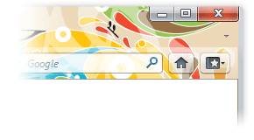
Dress Up Firefox with Personas
Change the look of your Firefox to practically anything with Personas
Thousands of easy-to-install themes created by users from around the world (or that you make yourself!).

Slide 25

Beyond Add-Ons
Add new search engines, change toolbar prefs, customize your browser’s navigation & more.
Set a Web mail client open up when you click on an address
Set up a news reader in your browser for your blogs and feeds

Slide 26

The Cutting Edge
HTML5, CSS3 & More

Slide 27

HTML5-Ready Parser
Firefox includes an HTML5-ready parser
Inline SVG
Better performance
Notes:
Parser
Firefox includes an HTML5-ready parser. This parser brings with it some new capabilities, most notably inline SVG, but also improves performance by running the parsing algorithm on its own processor.

Slide 28

Stylin’ Pages with CSS3
Support for new CSS3 awesomenewss
border-radius
box-shadow
Other Transitions, Animations and Transformations

Slide 29

Next Generation Graphics
Text and graphic rendering is faster including SVG & Canvas
Auto color-correction of images

Slide 30

Newest Web Technologies
WebM and HD Video
Enhanced File API
Audio API
Multi-Touch Support
Web Console
Notes:
WebM and HD Video: As pioneers of HTML5 video standards, Firefox also supports the WebM format so you can watch open HD-quality video.
Enhanced File API: With added support for .click() to the File upload control, .slice and file API urls, Firefox allows developers to better customize the file upload experience.
Audio API: Firefox is changing the way media is integrated on the Web. HTML5 makes it easy for developers to use JavaScript to read and write audio data. We’ve exposed the raw audio data so you can create great sounds!
Multi-touch Support
Firefox now integrates multi-touch support for Windows 7, enabling you to interact with your browser in a whole new way.
Web Console
Want to know what makes cutting-edge sites tick? Firefox allows you to peek under the hood of dynamic web pages with this experimental analysis tool.

Slide 31

Universal Access
Accessibility, Translations & More

Slide 32

Emphasis on Accessibility
Firefox is easier to use for those with mobility disabilities and visual impairments.
Notes:
By minimizing keystrokes, allowing users to zoom in on Web pages and supporting screen readers,

Slide 33
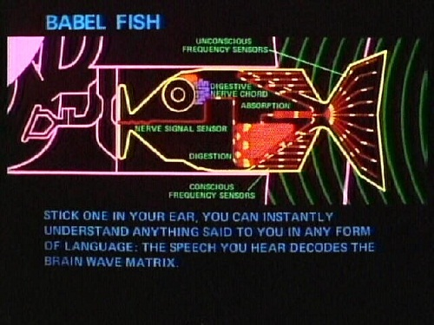
The Language of Firefox
Firefox is available in as many languages as possible.
We have over 85 translations, from French and Chinese to Finnish and Czech.

Slide 34

Fabulous Fonts
Open font support, such as WOFF, TrueType & OpenType,
Better Text Rendering
Notes:
Better Text Rendering: Read your language as it’s written—more like real life. Our graphics engine renders Arabic, Persian, Punjabi and other script languages in a remarkably seamless way.

Slide 35

Mozilla Mission
Promote openness, innovation and opportunity on the web.
Mozilla.org/firefox
http://www.flickr.com/photos/kerolic/5803257147/

